Slide 1


Slide 3

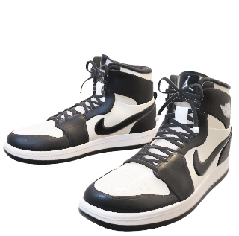
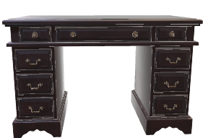


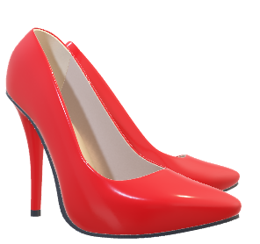

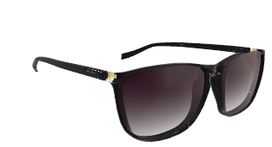

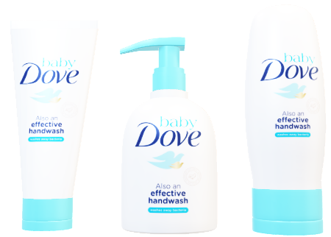




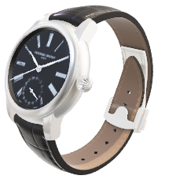
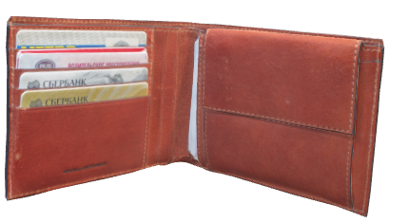

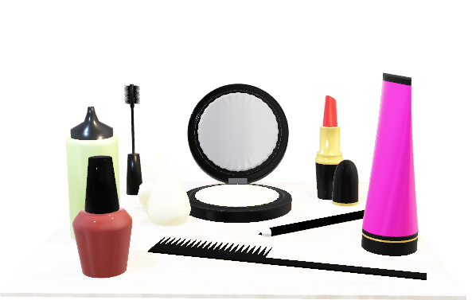

Slide 4
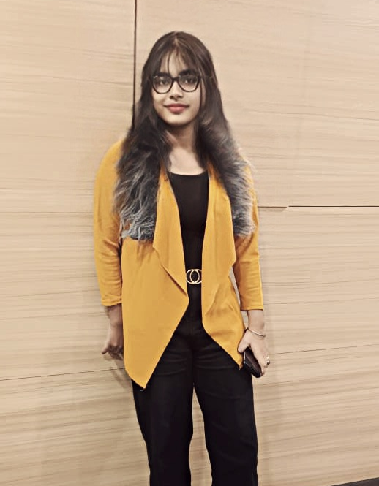
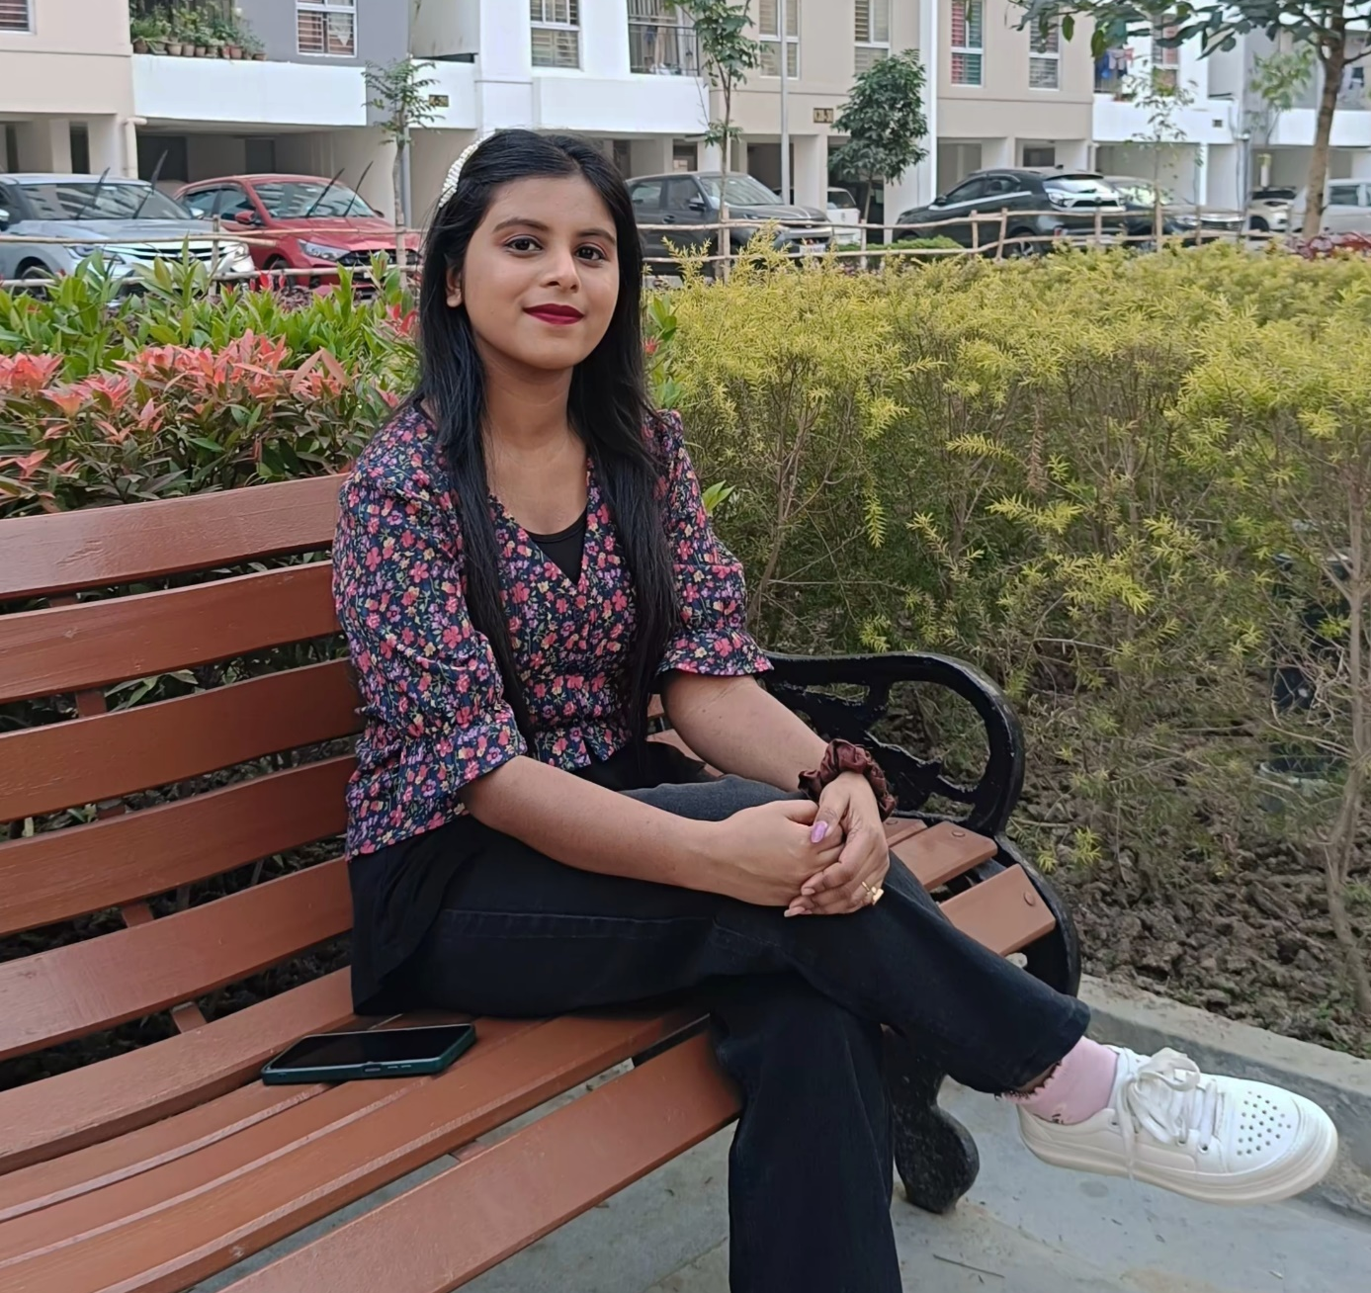

OUR TEAM
Suparna Biswas
Enrollment No:
2112200001128
1/3

Slide 5
OUR TEAM
Sneha Khan
Enrollment No:
2112200001125
2/3

Slide 6
OUR TEAM
Isita Jana
Enrollment No:
2112200001106
3/3

Slide 7
CONTENTS
INTRODUCTION
VISION & MISSION
FOUNDER & TEAM
REVENUE MODEL
BUSINESS MODEL

Slide 8
MARKETING STRATEGY
CHALLENGES FACED
FUTURE PLANS
GROWTH
CONCLUSION

Slide 9



THE STARTUP STORY

Slide 10

INTRODUCTION
INTRODUCTION
INTRODUCTION
INTRODUCTION
INTRODUCTION

Slide 11


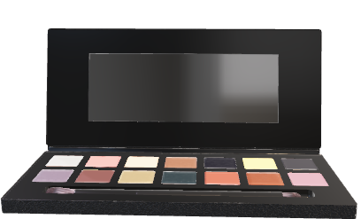
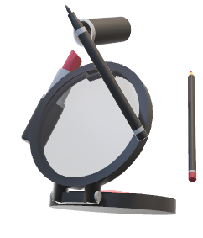
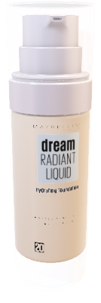
INTRODUCTION
INTRODUCTION
INTRODUCTION
INTRODUCTION
INTRODUCTION

Slide 12
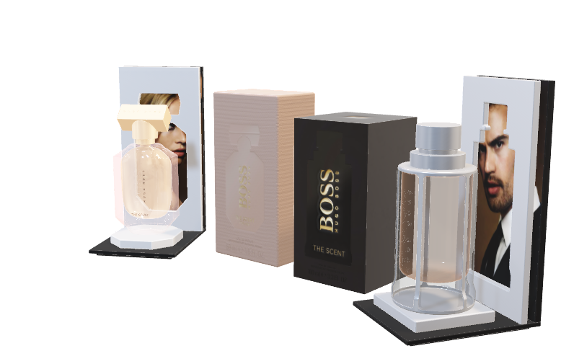


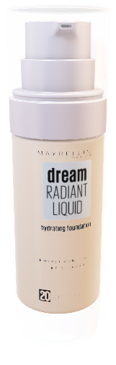
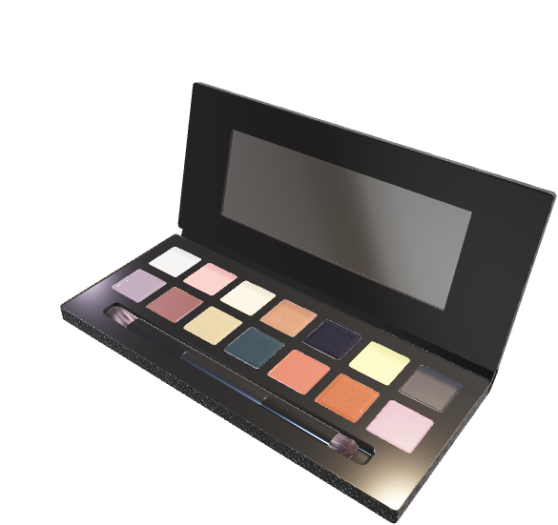
INTRODUCTION
The demand for beauty goods, especially from teens and young people, is driving the cosmetics industry's extraordinary rise. The industry's fast digitalization has accelerated its growth even more.
Nykaa becomes a major force in this thriving market, providing physical and virtual customers with a wide selection of beauty, fashion, and wellness products.
Nykaa is a beauty retail company that sells cosmetic commodities and fashion products, including men's innerwear, both online and offline.
The company also offers comprehensive content that includes product reviews, beauty how-to videos, expert-written articles, and even an e-beauty magazine.

Slide 13


Slide 15
FOUNDER AND TEAM
Nykaa was established in 2012 by Falguni Nayar.
Falguni Nayar, the Co-Founder and CEO of Nykaa is a very successful women with an excellent background in both education and work.
Nayar is one of two self-made female Indian billionaires.
With just three workers, she started Nykaa with little experience in the retail, beauty or IT sectors.

Slide 16
MISSION
&
VISION
The mission on the company's website states, “To create a world where our consumers have access to a finely curated, authentic assortment of products and services that delight and elevate the human spirit.”
The vision on the company's website states, "Bring inspiration and joy to people, everywhere, everyday.”

Slide 17
MISSION
&
VISION
The mission on the company's website states, “To create a world where our consumers have access to a finely curated, authentic assortment of products and services that delight and elevate the human spirit.”
The vision on the company's website states, "Bring inspiration and joy to people, everywhere, everyday.”

Slide 18

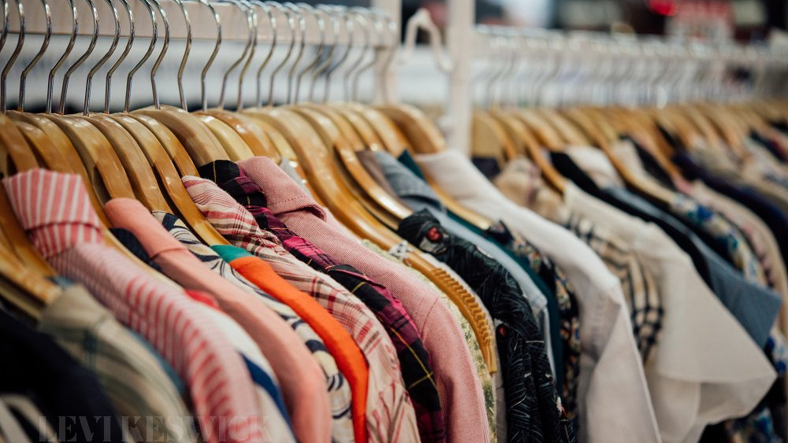
Business Model
Nykaa is a D2C consumer products eCommerce brand, that relies on an inventory-based business model. The company purchases its products directly from the manufacturers and keeps them in its designated warehouses located in New Delhi, Mumbai, and Bangalore.The inventory-led model of business of the company helps the company witness high-profit margins and has resulted in a profitable business.
Also Nykaa has a physical presence in 38 different cities in India including Kolkata. The products are sold either on the website of Nykaa or through its 3 offline store formats: Nykaa Luxe, Nykaa On Trend, and Nykaa Kiosks.

Slide 19
Business Model
Nykaa is a D2C consumer products eCommerce brand, that relies on an inventory-based business model. The company purchases its products directly from the manufacturers and keeps them in its designated warehouses located in New Delhi, Mumbai, and Bangalore.The inventory-led model of business of the company helps the company witness high-profit margins and has resulted in a profitable business.
Also Nykaa has a physical presence in 38 different cities in India including Kolkata. The products are sold either on the website of Nykaa or through its 3 offline store formats: Nykaa Luxe, Nykaa On Trend, and Nykaa Kiosks.

Slide 20
Business Model
Nykaa is a D2C consumer products eCommerce brand, that relies on an inventory-based business model. The company purchases its products directly from the manufacturers and keeps them in its designated warehouses located in New Delhi, Mumbai, and Bangalore.The inventory-led model of business of the company helps the company witness high-profit margins and has resulted in a profitable business.
Also Nykaa has a physical presence in 38 different cities in India including Kolkata. The products are sold either on the website of Nykaa or through its 3 offline store formats: Nykaa Luxe, Nykaa On Trend, and Nykaa Kiosks.

Slide 21
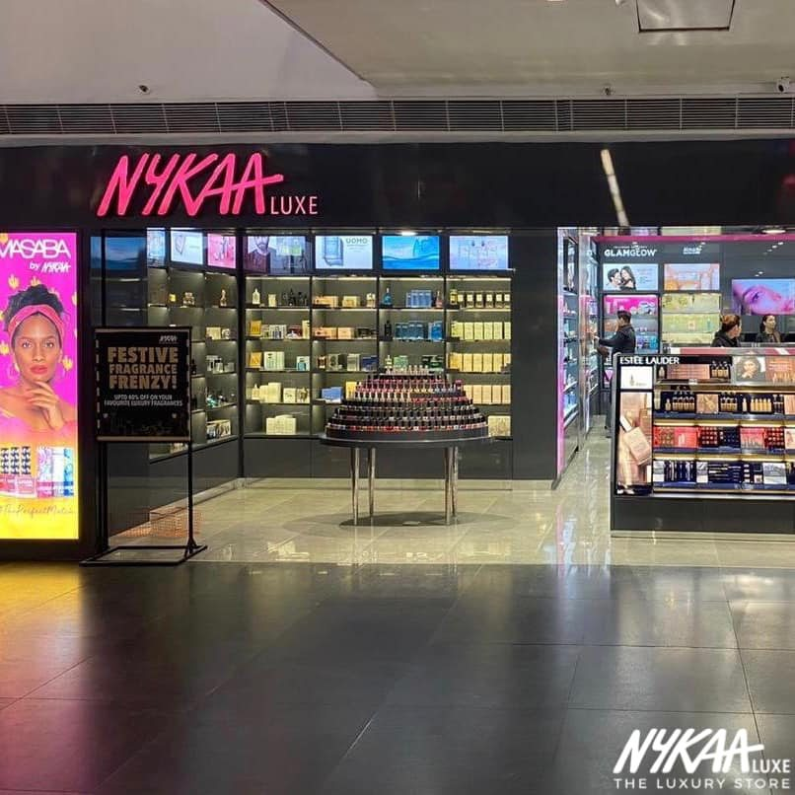
REVENUE MODEL

Slide 22

REVENUE MODEL
Nykaa earns its revenues through the below-mentioned means.
Sale of products
The brand sells its own products and the products of its partnered brands, which is the primary source of revenue for the brand.

Slide 23

REVENUE MODEL
Banner advertisements
The banner advertisements of the company also help it bring in a lot of traffic, many of which turn into sales.
Discount income, income from commissions, and miscellaneous income are some other sources of revenue for the brand.

Slide 24

Marketing StrategY

Slide 25

Marketing StrategY
Nykaa has a strong and robust Omnichannel marketing strategy.
CONTENT
MARKETING

Slide 26


Marketing StrategY
Nykaa has a strong and robust Omnichannel marketing strategy.
YOUTUBE
MARKETING
CONTENT
MARKETING
SOCIAL MEDIA
MARKETING

Slide 27
Nykaa has a strong and robust Omnichannel marketing strategy.
YOUTUBE
MARKETING
CONTENT
MARKETING
SOCIAL MEDIA MARKETING
Nykaa has 4 social media accounts My Nykaa, Nykaa beauty
Nykaa fashion and Nykaa beauty book.
Influencer marketing also plays an important role in the promotion of Nykaa.

Slide 28
Nykaa has a strong and robust Omnichannel marketing strategy.
YOUTUBE
MARKETING
CONTENT MARKETING
SOCIAL MEDIA
MARKETING
Nykaa relies majorly on its content marketing.
Nykaa has its own blog, “Nykaa beauty book,” which the brand uses to publish blogs on beauty, makeup, and personal care.
Event marketing is another important marketing strategy that Nykaa leverages to pitch the target customers at the right time and right place.

Slide 29
Nykaa has a strong and robust Omnichannel marketing strategy.
YOUTUBE MARKETING
CONTENT
MARKETING
SOCIAL MEDIA
MARKETING
Nykaa has a full fledged YouTube marketing strategy.
The brand also runs YouTube ads from time to time to attract its customers.
The YouTube marketing of Nykaa is fueled with quality content that keeps the audience engaged and relevant ads.

Slide 30
Marketing StrategY
Nykaa has a strong and robust Omnichannel marketing strategy.
YOUTUBE
MARKETING
CONTENT
MARKETING
SOCIAL MEDIA
MARKETING

Slide 31


CHALLENGES FACED

Slide 32
CHALLENGES FACED
1.
Nykaa has become a dominant force in the Indian beauty e-commerce market, but it is important to recognize that competition is always changing.
2.
Prominent entities like Ajio and Myntra pose intense competition, contributing to the intricacy of Nykaa's market dynamics.
3.
Nykaa experienced technical difficulties in its early stages, with its website routinely crashing as order volume increased.
4.
Nykaa faces a variety of obstacles as a result of its competitors' constant evolution, necessitating constant innovation and tactical adjustment.
5.
The competition creates a market with lots of options, affordable prices, and better services, which eventually improves the Indian consumer's entire experience shopping for
beauty products.

Slide 33
CHALLENGES FACED
1.
Nykaa has become a dominant force in the Indian beauty e-commerce market, but it is important to recognize that competition is always changing.
2.
Prominent entities like Ajio and Myntra pose intense competition, contributing to the intricacy of Nykaa's market dynamics.
3.
Nykaa experienced technical difficulties in its early stages, with its website routinely crashing as order volume increased.
4.
Nykaa faces a variety of obstacles as a result of its competitors' constant evolution, necessitating constant innovation and tactical adjustment.
5.
The competition creates a market with lots of options, affordable prices, and better services, which eventually improves the Indian consumer's entire experience shopping for
beauty products.

Slide 34
CHALLENGES FACED
1.
Nykaa has become a dominant force in the Indian beauty e-commerce market, but it is important to recognize that competition is always changing.
2.
Prominent entities like Ajio and Myntra pose intense competition, contributing to the intricacy of Nykaa's market dynamics.
3.
Nykaa experienced technical difficulties in its early stages, with its website routinely crashing as order volume increased.
4.
Nykaa faces a variety of obstacles as a result of its competitors' constant evolution, necessitating constant innovation and tactical adjustment.
5.
The competition creates a market with lots of options, affordable prices, and better services, which eventually improves the Indian consumer's entire experience shopping for
beauty products.

Slide 35
CHALLENGES FACED
1.
Nykaa has become a dominant force in the Indian beauty e-commerce market, but it is important to recognize that competition is always changing.
2.
Prominent entities like Ajio and Myntra pose intense competition, contributing to the intricacy of Nykaa's market dynamics.
3.
Nykaa experienced technical difficulties in its early stages, with its website routinely crashing as order volume increased.
4.
Nykaa faces a variety of obstacles as a result of its competitors' constant evolution, necessitating constant innovation and tactical adjustment.
5.
The competition creates a market with lots of options, affordable prices, and better services, which eventually improves the Indian consumer's entire experience shopping for
beauty products.

Slide 36
CHALLENGES FACED
1.
Nykaa has become a dominant force in the Indian beauty e-commerce market, but it is important to recognize that competition is always changing.
2.
Prominent entities like Ajio and Myntra pose intense competition, contributing to the intricacy of Nykaa's market dynamics.
3.
Nykaa experienced technical difficulties in its early stages, with its website routinely crashing as order volume increased.
4.
Nykaa faces a variety of obstacles as a result of its competitors' constant evolution, necessitating constant innovation and tactical adjustment.
5.
The competition creates a market with lots of options, affordable prices, and better services, which eventually improves the Indian consumer's entire experience shopping for
beauty products.

Slide 37
Nykaa Ranks Behind Purplle, AJIO And Myntra In Average Visit Duration
5
4
3
2
1
0

Slide 38






Nykaa Ranks Behind Purplle, AJIO And Myntra In Average Visit Duration
5
4.43
4.22
4
3.58
3.02
Average Visit Duration
3
2.51
2
1.33
1
0

Slide 39
GROWTH
Nykaa experienced a major growth in 2015, moving from an online-only business model to an omnichannel strategy.
It has 1900+ brands with 1.2 lakh+ products as of January 2024.
Some of the popular brands are Lakme, Loreal Paris, Maybelline New York, Nivea, Dot & Key, and many more.
Nykaa claims to have $21 million users as of November 2023.
It has 23 warehouses across 11 Indian cities.
Nykaa plans to open 180 stores by 2024.

Slide 40
GROWTH
Nykaa experienced a major growth in 2015, moving from an online-only business model to an omnichannel strategy.
It has 1900+ brands with 1.2 lakh+ products as of January 2024.
Some of the popular brands are Lakme, Loreal Paris, Maybelline New York, Nivea, Dot & Key, and many more.
Nykaa claims to have $21 million users as of November 2023.
It has 23 warehouses across 11 Indian cities.
Nykaa plans to open 180 stores by 2024.

Slide 41
GROWTH
Financials
Nykaa experienced a major growth in 2015, moving from an online-only business model to an omnichannel strategy.
It has 1900+ brands with 1.2 lakh+ products as of January 2024.
Some of the popular brands are Lakme, Loreal Paris, Maybelline New York, Nivea, Dot & Key, and many more.
Nykaa claims to have $21 million users as of November 2023.
It has 23 warehouses across 11 Indian cities.
Nykaa plans to open 180 stores by 2024.

Slide 42
Financials
FY21
FY22
FY23
6,000
5,000
4,000
3,000
Amount in Rs Crore
2,000
1,000
0
-1,000
Operating Revenue
Total Expenses
Profit/Loss
Cash from Ops

Slide 43
Financials
FY21
FY22
FY23
6,000
5,144
5,135
5,000
4,000
3,774
3,753
3,000
Amount in Rs Crore
2,441
2,386
2,000
1,000
21
133
61.6
41.3
0
-354
-140
-1,000
Operating Revenue
Total Expenses
Profit/Loss
Cash from Ops

Slide 44

FUTURE PLANS

Slide 45
FUTURE PLANS
Nykaa, a prominent participant in the e-commerce industry, is proactively molding its future through the expansion of its multichannel reach, with the objective of flawlessly merging customers' online and offline purchasing experiences.
As part of its plan for the future, Nykaa is dedicated to improving its physical footprint even with the expenses that come with opening new locations .
Setting lofty objectives, such as the intended opening of 180 stores throughout India by 2024 a substantial advancement in its brick-and-mortar expansion strategy the company hopes to build a strong future.

Slide 46
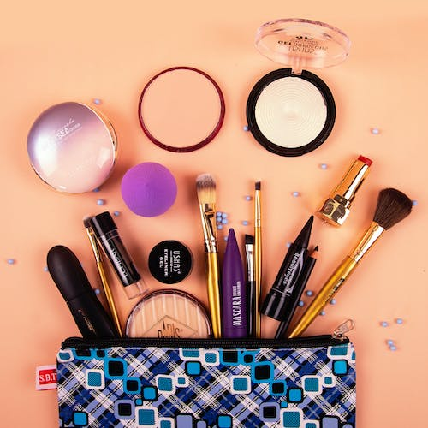

CONCLUSION
Nykaa has become a prominent player in India's e- commerce industry with its unique business model that focuses on providing high-quality beauty and wellness products, excellent customer service and innovative marketing strategies.
Nayar's entrepreneurial journey and the success of Nykaa have disrupted the Indian beauty market, empowering women with a vast array of choices and transforming the way they shop for beauty products.
With her dedication, vision and relentless pursuit of her dreams, Nayar has built a billion dollar empire that stands as a testament to her entrepreneurial spirit.
Nayar has proven that age is no barrier to pursuing one's dreams and achieving remarkable success.

Slide 47

THANK YOU

